Slide 1
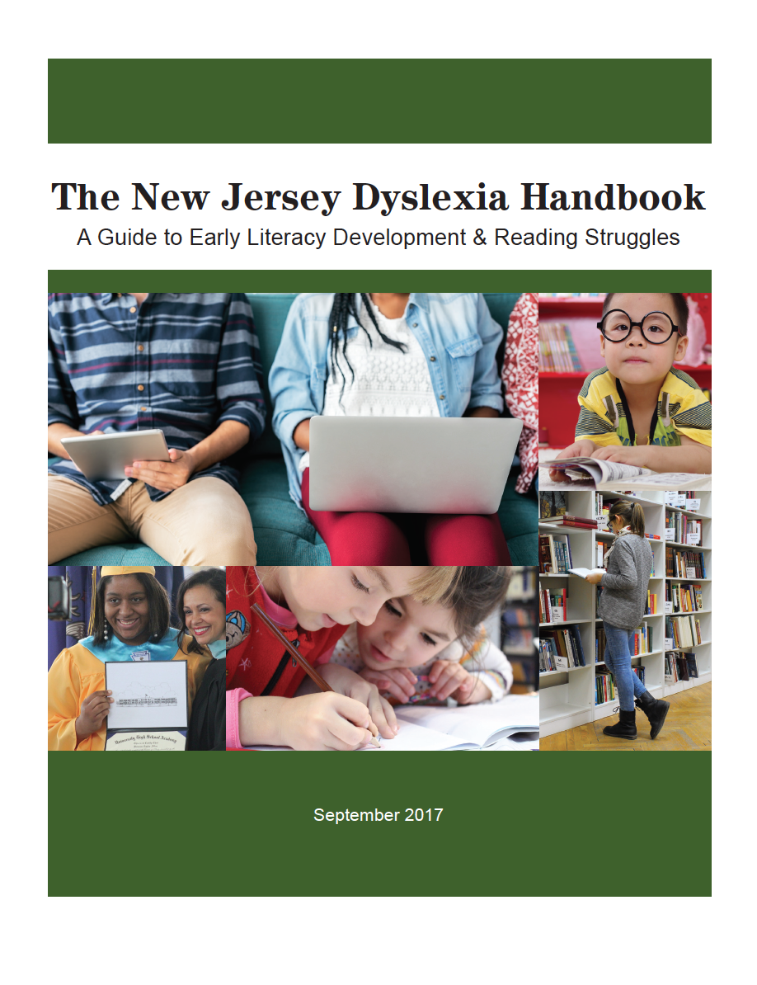
Exploring The New Jersey Dyslexia Handbook: A Guide to Early Literacy Development & Reading Struggles
Session 1
Notes:
Welcome to “Exploring the New Jersey Dyslexia Handbook: A Guide to Early Literacy Development and Reading Struggles.” This four part webinar series is approximately 1 hour and 20 minutes in total length with each individual session lasting about 20 minutes. Each session is designed to help school districts become familiar with the guidance contained in the state handbook and to support district-based stakeholder teams in making the best educational programming decisions for the students in their schools. This series can be used as an implementation tool for districts interested in building a strong preventive model of screening and tiered intervention for students struggling in the area of reading. Each installment will provide team members with an overview of content and activities to support the team members in translating the information discussed into best practices in their schools and classrooms. Your team should plan for additional time to complete the coordinated activities.
In this first session, we will review the purpose of the state dyslexia handbook, consider the formal definition of dyslexia included in the NJ administrative code, and discuss what comprehensive literacy instruction can look like for all students in the state.

Slide 2
Dyslexia Handbook Committee
Notes:
In order to assure a broad representation for input into the handbook, a diverse group of individuals with expertise in literacy and learning disabilities were brought together to develop this guidance document in collaboration with New Jersey Department of Education representatives. These individuals represented a wide array of stakeholders including teachers, service providers, child study team members, school administrators, higher ed faculty, and parents.

Slide 3
Purpose
Build an understanding of dyslexia and related difficulties with written language
Demonstrate how to identify and remediate students with dyslexia and other reading difficulties
Inform both educators and families in best practices to support students with dyslexia and other reading difficulties
Notes:
The purpose of The New Jersey Dyslexia Handbook: A Guide to Early Literacy Development & Reading Struggles is to provide information about dyslexia, early literacy development, and best practices for identification, instruction, and accommodation of students with reading difficulties to the educators and families of school districts across the state.
With this goal in mind, the intent is:
To build an understanding of dyslexia and related difficulties with written language;
To demonstrate how to identify and remediate students with dyslexia and other reading difficulties; and
To inform both educators and families in best practices to support students with dyslexia and other reading difficulties.
While New Jersey school districts have considerable autonomy in making decisions about diagnostic tools and instructional programs, the handbook and this accompanying webinar series can provide guidance for administrators, teachers, board of education members, and parents for assessing school- or district-based systems, and for identifying the evidence-based interventions and accommodations needed to support students suspected of having reading difficulties in a timely and effective manner.

Slide 4
Definition
Dyslexia is a specific learning disability that is neurobiological in origin. It is characterized by difficulties with accurate and/or fluent word recognition and by poor spelling and decoding abilities. These difficulties typically result from a deficit in the phonological component of language that is often unexpected in relation to other cognitive abilities and the provision of effective classroom instruction. Secondary consequences may include problems in reading comprehension and reduced reading experience that can impede the growth of vocabulary and background knowledge. (N.J.A.C. 6A: 14-1.3)
Notes:
In August 2013, a state law was passed incorporating the International Dyslexia Association’s definition of dyslexia into chapter 14 of Title 6A of the New Jersey Administrative Code.
This definition reads: Dyslexia is a specific learning disability that is neurobiological in origin. It is characterized by difficulties with accurate and/or fluent word recognition and by poor spelling and decoding abilities. These difficulties typically result from a deficit in the phonological component of language that is often unexpected in relation to other cognitive abilities and the provision of effective classroom instruction. Secondary consequences may include problems in reading comprehension and reduced reading experience that can impede the growth of vocabulary and background knowledge.
When parents and educators use the same terminology to describe a student’s challenges, it is easier for them to communicate and work together. Parents and educators may have different opinions about using specific terms like dyslexia or more general terms like specific learning disabilities. Understanding these terms can help prevent confusion and conflict and can also lead to a shared understanding of a student’s needs. The handbook provides additional discussion points regarding the state’s definition of dyslexia.

Slide 5
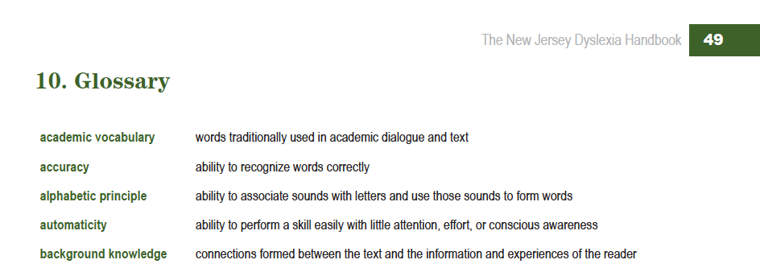
Glossary & Additional Resources
Notes:
The handbook also includes a glossary of terms for your reference and makes note that the development of additional dyslexia resources will be ongoing.
Currently, the New Jersey Department of Education website hosts a Dyslexia Resources section. On the “Professional Development” tab, professional development webinars are available. The content for these webinars was developed and presented by the New Jersey Branch of the International Dyslexia Association in collaboration with the NJ Department of Education. The NJDOE website contains additional resources for families, educators and community members regarding the New Jersey Student Learning Standards, best practices, and professional development opportunities.

Slide 6
Comprehensive Literacy Instruction for All
The Role of NJSLS with Implications for Struggling Readers: Within the K-5 reading standards are foundational skills including print concepts, phonological awareness, phonics (decoding and spelling), sight word recognition, word structure and fluency. These critical skills underlie the development of independent reading and comprehension abilities and are of particular importance for students with dyslexia, as well as many other students who struggle with word level skills. These students require specific, intensive and systematic instruction in these foundational skills as an essential part of their program.
Notes:
The guidelines outlined in the Comprehensive Literacy Instruction for All section of the handbook are intended to provide a framework for literacy instruction and to guide districts and schools in their efforts to provide the structure, curriculum and interventions needed to ensure that all students are successful in learning the New Jersey Student Learning Standards for English Language Arts.

Slide 7
Comprehensive Literacy Instruction for All
The Role of NJSLS with Implications for Struggling Readers: Within the K-5 reading standards are foundational skills including print concepts, phonological awareness, phonics (decoding and spelling), sight word recognition, word structure and fluency. These critical skills underlie the development of independent reading and comprehension abilities and are of particular importance for students with dyslexia, as well as many other students who struggle with word level skills. These students require specific, intensive and systematic instruction in these foundational skills as an essential part of their program.
Notes:
Within the K-5 reading standards are foundational skills including print concepts, phonological awareness, phonics (decoding and spelling), sight word recognition, word structure and fluency. These critical skills underlie the development of independent reading and comprehension abilities and are of particular importance for students with dyslexia, as well as many other students who struggle with word level skills. These students require specific, intensive and systematic instruction in these foundational skills as an essential part of their literacy instruction program.

Slide 8
Comprehensive Literacy Instruction for All
Structuring the Literacy Block to Maximize Learning for Struggling Readers:
A minimum of 90 minutes of uninterrupted literacy instruction daily in grades K-5.
A minimum of 80 minutes for grades 6-8 in order to accommodate content/departmental classes at those grade levels.
A block of 120 minutes is suggested for bilingual/ESL classes to allow additional allocated time for second language instruction and support.
Notes:
In this section, the NJDOE also provides guidance on ways to structure the literacy block to maximize learning for struggling readers:
a minimum of 90 minutes of uninterrupted literacy instruction daily in grades K-5;
a minimum of 80 minutes for grades 6-8 in order to accommodate content/departmental classes at those grade levels;
and a block of 120 minutes is suggested for bilingual/ESL classes to allow additional allocated time for second language instruction and support.
Uninterrupted instruction means that NO students are pulled for related services during the ELA block and NO other classes are scheduled that would break the block into smaller parts. This means no scheduling of specials, lunch, recess that would interrupt the instruction. This guidance also applies to students with Individualized Education Programs.
These allotments are minimum recommendations. A district may decide that in order to provide for adequate instruction and practice they will exceed these literacy block suggestions.

Slide 9
Comprehensive Literacy Instruction for All
Struggling students regardless of grade level will require more instructional time and more systematic and intensive instruction to make progress in the standards.
Some will require instruction in foundational or other skills specified in the standards for students at lower grade levels.
Supports and services can, and should be, provided within the literacy block as well as an additional intervention period to supplement literacy instruction beyond the block.
As students get older and the gap between actual and expected achievement broadens, more time and increased intensity of instruction will be needed.
Notes:
The key take-aways from this section include the following:
Struggling students regardless of grade level will require more instructional time and more systematic and intensive instruction to make progress in the standards; and
Some will require instruction in foundational or other skills specified in the standards for students at lower grade levels. Even though foundational skills are only included in the K-5 reading standards, it is important to remember that the standards acknowledge that interventions and supports for students, whose achievement is below or way below grade level, need to be in place. Students beyond grade 5 who struggle with reading will most likely need systematic instruction and intensive intervention on standards addressed at lower grade levels, such as phonemic awareness, early phonics and word recognition skills, as well as fluency.
Always remember that struggling readers need more time, not less, than their peers to develop literacy skills. Supports and services such as structured literacy instruction can, and should be, provided both within the literacy block as well as within an additional intervention period to supplement literacy instruction beyond the block.
As students get older and the gap between actual and expected achievement broadens, more time and increased intensity of instruction will be needed. For example, if a student is identified as a struggling reader in kindergarten, he or she may typically make progress with 30 minutes of daily intervention. However, if a struggling reader is not identified until 4th grade, research out of the National Institute of Child Health and Human Development predicts he or she will likely need up to 120 minutes of daily intervention to make the same progress.

Slide 10
Comprehensive Literacy Instruction for All
Structured literacy instruction is an approach for ALL students who fail to meet screening benchmarks or are observed by their teachers to struggle with reading and writing.
Struggling readers will require access to accommodations for close reading, vocabulary building and use of more advanced reading strategies when working with grade level text.
⇨ TOOL: Key Principles of Comprehensive Literacy Instruction
Notes:
Structured literacy instruction is explicit, systematic and cumulative, hands-on, engaging, multimodal, and diagnostic and responsive. This type of literacy instruction is not just for special education students or those diagnosed with specific learning disabilities. Structured literacy instruction is an approach for ALL students who fail to meet screening benchmarks or are observed by their teachers to struggle with reading and writing.
In addition to effective reading instruction, struggling readers in both general education and special education will require access to accommodations for close reading, vocabulary building, and use of more advanced reading strategies when working with grade level text. This could include the use of audiobooks and other text to speech technologies to provide access to grade level reading materials.
At the end of this section, there is a tool called Key Principles of Comprehensive Literacy Instruction.

Slide 11
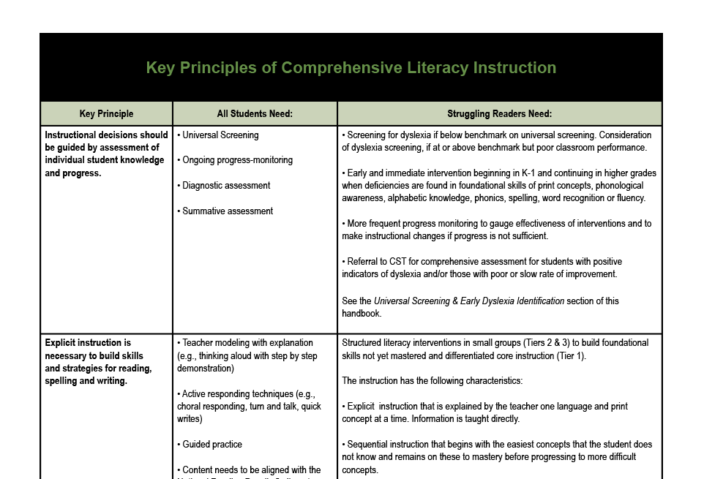
Notes:
You might find this document to be a valuable survey or training tool at your next professional learning community, grade level team, or other peer collaboration group meeting. The first column lists the key principle of instruction, the middle column states what all students need, and the last column explains what additional support struggling readers will need relative to the key principle.

Slide 12
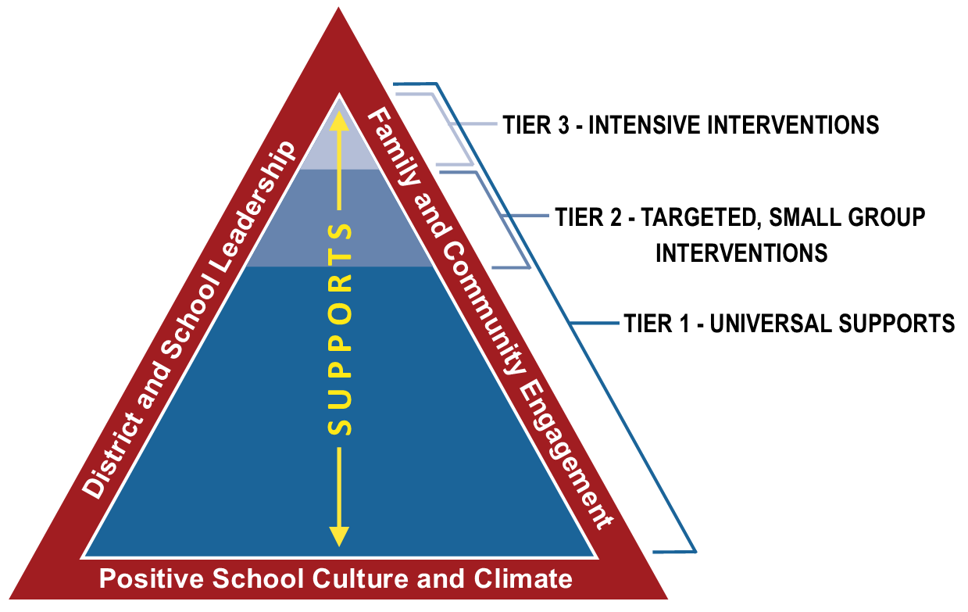
NJ Tiered Systems of Support
Notes:
The guidance provided in The NJ Dyslexia Handbook also has implications within current Intervention and Referral Services regulations and the New Jersey Tiered Systems of Support framework. One way to implement the I&RS regulations is through implementation of NJTSS. NJTSS calls for universal screening of all students two to three times per school year in addition to a process for individual student referral. The recommendations around screening tools and practices, evidence-based interventions, and accommodations provided in this handbook provide a systematic approach to addressing learner variability early and engaging all students in literacy skill development.
As we bring this first session of the webinar series to a close, we will leave you with two follow up activities. These activities are intended to support your team members in translating the information discussed into best practices in your schools and classrooms.

Slide 13
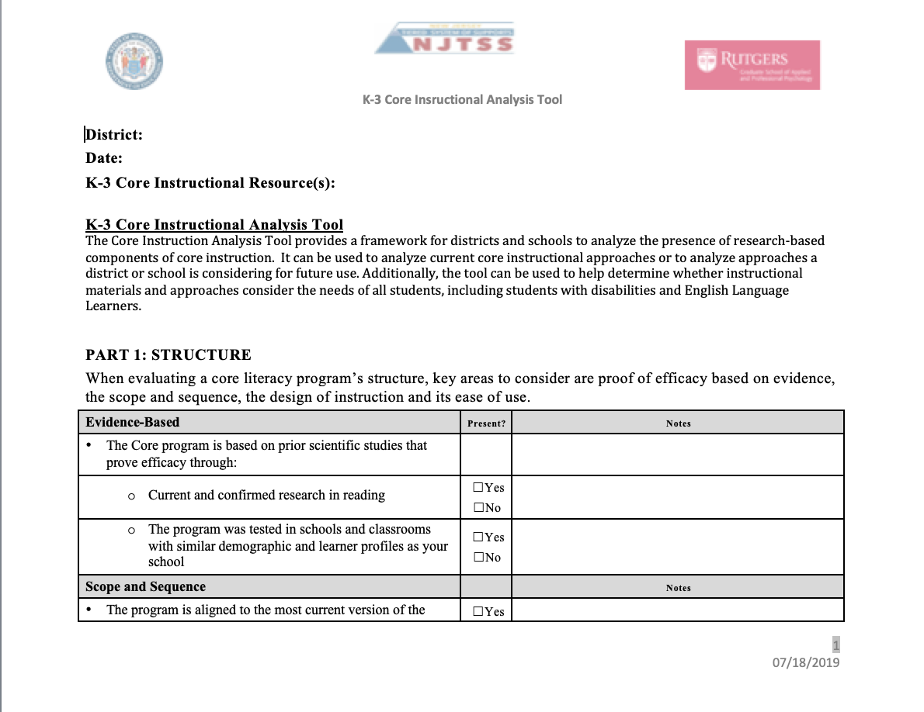
Activity: Analyze Your Core Literacy Instruction
⇨ TOOL: NJTSS K-3 Core Instructional Analysis Tool
Source: https://www.nj.gov/education/njtss/
Notes:
The NJ Department of Education has introduced many tools to support districts in implementing successful Tiered Systems of Support models for literacy intervention. The K-3 Core Instructional Analysis Tool provides a framework for districts and schools to analyze the presence of research-based components of core instruction. This tool can be used by a stakeholder team to analyze your current core instructional approaches or to analyze approaches you may be considering for future use. Additionally, this tool can be used to help determine whether instructional materials and approaches consider the needs of all students, including students with disabilities and English Language Learners.
At the close of this webinar, take some time to think about how this tool can be used in your school or district to assess the quality and effectiveness of your core, tier 1 literacy instruction and curriculum materials. One recommendation may be to establish grade-level teams who will use the tool to analyze the structure and key areas of skill development within your core literacy program. This type of analysis can help you identify areas of strength, as well as areas where you may need to supplement the program with additional instructional materials in order to deliver comprehensive literacy instruction for all students.

Slide 14
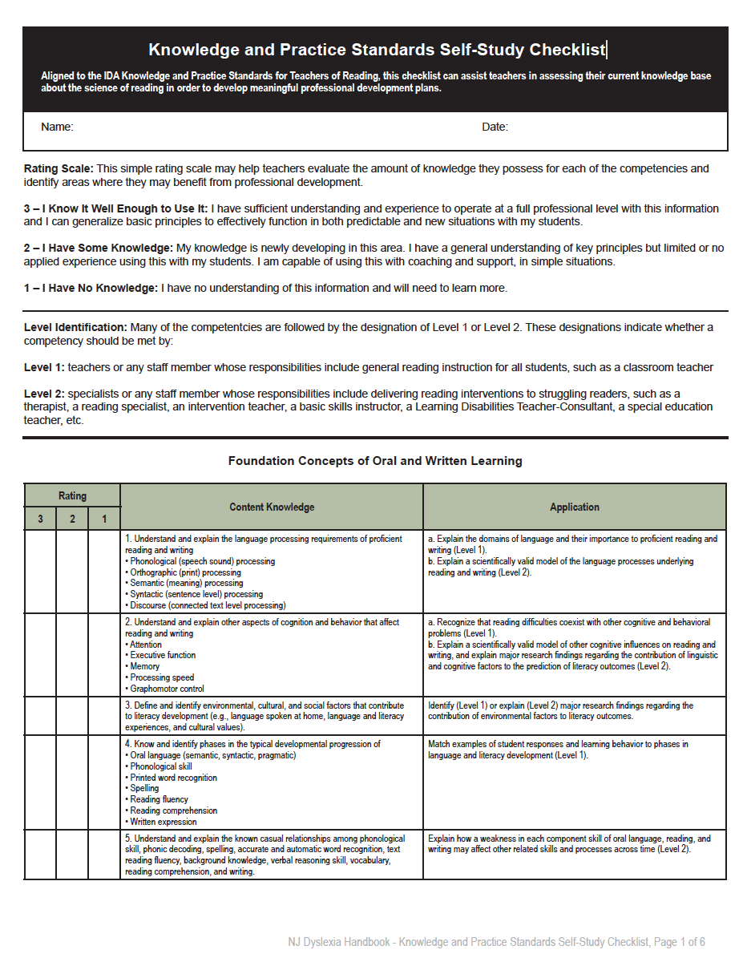
Activity:
Teacher Knowledge Checklist
⇨ TOOL: Knowledge and Practice Standards Self-Study Checklist
Source: https://dyslexiaida.org/knowledge-and-practices/
Notes:
This second suggested activity will build on your team’s core instructional analysis work. We all know that programs don’t teach students to read, teachers do! So this next activity will shift focus to teacher knowledge.
Included in the dyslexia handbook is the Knowledge and Practice Standards Self-Study Checklist. Aligned to the 2010 edition of the International Dyslexia Association’s Knowledge and Practice Standards for Teachers of Reading, this checklist can assist teachers in assessing their current knowledge base about the science of reading in order to develop meaningful professional development plans. The Knowledge and Practice Standards for Teachers of Reading explicitly set forth the knowledge and skills that all teachers of reading are expected to possess to advance students’ reading and writing profiles from a Structured Literacy approach in the classroom, remedial, and clinical settings. It should be noted that the International Dyslexia Association released a second edition of these knowledge and practice standards in 2018. This updated set of standards can be referenced at their website.
The Knowledge and Practice Standards Self-Study Checklist can be used independently by teachers or by a group of educators within a professional learning community to take a quick look at areas of potential focus for future professional development planning. The rating scale provided is intended to note the level of knowledge teachers possess for each competency listed and to identify areas where professional development may be needed.
Take some time to think about how this tool can be used in your school to drive and/or support your professional development planning process.

Slide 15
Thank You!
Reminder: Complete the activities included here and then tune in for Session 2
Notes:
We’ll look forward to having you join us for session 2 of Exploring the New Jersey Dyslexia Handbook: A Guide to Early Literacy Development and Reading Struggles in the near future.

